Slide 1
CAKEPHP
Blog tutorial

Slide 2
what you’ll need
A running web server
A database server
Basic PHP knowledge
basic knowledge of the MVC

Slide 3
Database
/* First, create our posts table: */
CREATE TABLE posts (
id INT UNSIGNED AUTO_INCREMENT PRIMARY KEY,
title VARCHAR(50),
body TEXT,
created DATETIME DEFAULT NULL,
modified DATETIME DEFAULT NULL
);
/* Then insert some posts for testing: */
INSERT INTO posts (title,body,created)
VALUES ('The title', 'This is the post body.', NOW());
INSERT INTO posts (title,body,created)
VALUES ('A title once again', 'And the post body follows.', NOW());
INSERT INTO posts (title,body,created)
VALUES ('Title strikes back', 'This is really exciting! Not.', NOW());

Slide 4
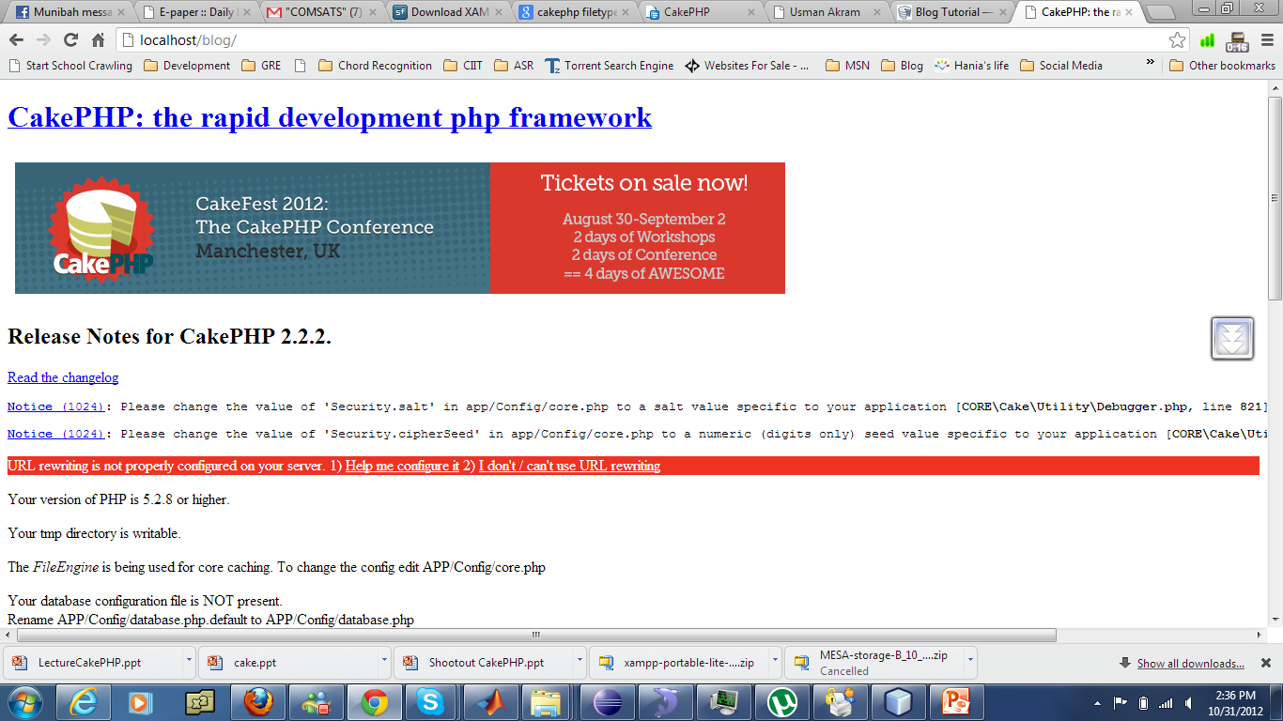
First ugly Look

Slide 5
A Note on mod_rewrite
Make sure that an .htaccess override is allowed
Make sure you are editing the correct httpd.conf
Make sure Apache is loading up mod_rewrite
LoadModule rewrite_module

Slide 6
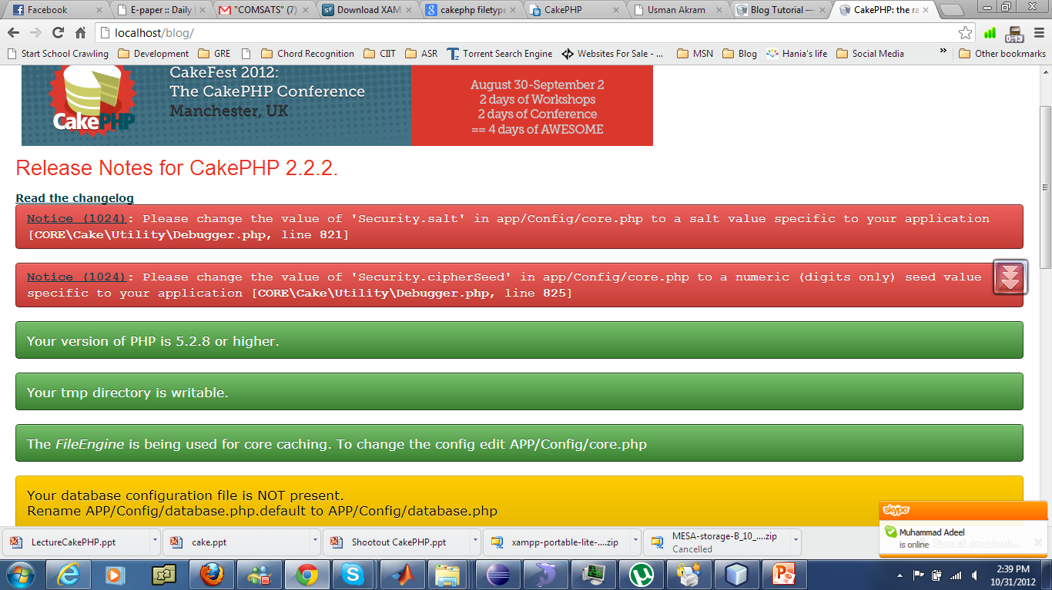
Half Done

Slide 7
Cake Database Configuration
/app/Config/database.php.default
Rename to database.php
Fill in your own DB configurations
/app/Config/core.php
Configure::write('Security.salt', 'pl345e-P45s_7h3*S@l7!');
Configure::write('Security.cipherSeed', '7485712659625147843639846751');

Slide 8
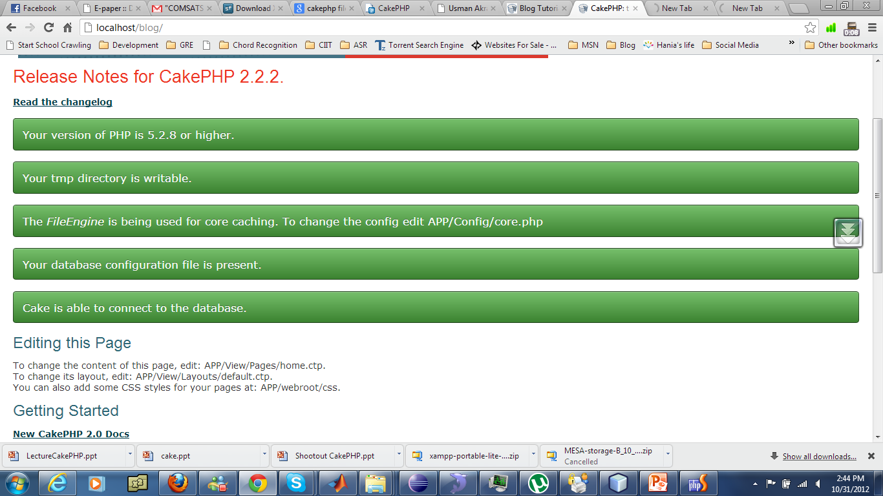
Ready to Go

Slide 9
Controller
class PostsController extends AppController {
public $helpers = array('Html', 'Form');
public function index() {
$this->set('posts', $this->Post->find('all'));
}
}

Slide 10
Index View
<?php foreach ($posts as $post): ?>
<tr>
<td><?php echo $post['Post']['id']; ?></td>
<td>
<?php echo $this->Html->link($post['Post']['title'],
array('controller' => 'posts', 'action' => 'view', $post['Post']['id'])); ?>
</td>
<td><?php echo $post['Post']['created']; ?></td>
</tr>
<?php endforeach; ?>

Slide 11
Add Action
public function add() {
if ($this->request->is('post')) {
$this->Post->create();
if ($this->Post->save($this->request->data)) {
$this->Session->setFlash('Your post has been saved.');
$this->redirect(array('action' => 'index'));
} else {
$this->Session->setFlash('Unable to add your post.');
}
}
}

Slide 12
Add View
<h1>Add Post</h1>
<?php
echo $this->Form->create('Post');
echo $this->Form->input('title');
echo $this->Form->input('body', array('rows' => '3'));
echo $this->Form->end('Save Post');
?>

Slide 13
What Helpers do
$this->Form->create()
<form id="PostAddForm" method="post" action="/posts/add">
$this->Html->link('Add Post', array('controller' => 'posts', 'action' => 'add'));
Hyper Link
echo $this->Form->postLink( 'Delete', array('action' => 'delete', $post['Post']['id']), array('confirm' => 'Are you sure?')); ?

Slide 14
Edit Action
public function edit($id = null) {
$this->Post->id = $id;
if ($this->request->is('get')) {
$this->request->data = $this->Post->read();
} else {
if ($this->Post->save($this->request->data)) {
$this->Session->setFlash('Your post has been updated.');
$this->redirect(array('action' => 'index'));
} else {
$this->Session->setFlash('Unable to update your post.');
}
}
}

Slide 15
Delete Action
public function delete($id) {
if ($this->request->is('get')) {
throw new MethodNotAllowedException();
}
if ($this->Post->delete($id)) {
$this->Session->setFlash('The post with id: ' . $id . ' has been deleted.');
$this->redirect(array('action' => 'index'));
}
}

Slide 16
Routes, /app/Config/routes.php
Router::connect('/', array('controller' => 'pages', 'action' => 'display', 'home'));
Router::connect('/', array('controller' => 'posts', 'action' => 'index'));

Slide 17
Layout
<?php echo $this->fetch('content'); ?>
echo $this->fetch('meta');
echo $this->fetch('css');
echo $this->fetch('script');

Slide 18
Switch layouts
public function admin_view() {
// stuff
$this->layout = 'admin';
}

Slide 19
Elements /app/View/Elements/helpbox.ctp
<?php echo $this->element('helpbox'); ?>
echo $this->element('helpbox', array( "helptext" => "Oh, this text is very helpful." ));

Slide 20
Scaffolding
<?php
class CategoriesController extends AppController {
public $scaffold;
}

Slide 21
Simple Authentication and Authorization Application
CREATE TABLE users (
id INT UNSIGNED AUTO_INCREMENT PRIMARY KEY,
username VARCHAR(50),
password VARCHAR(50),
role VARCHAR(20),
created DATETIME DEFAULT NULL,
modified DATETIME DEFAULT NULL
);

Slide 22
User Model
class User extends AppModel {
public $validate = array(
'username' => array(
'required' => array(
'rule' => array('notEmpty'),
'message' => 'A username is required'
)
),
'password' => array(
'required' => array(
'rule' => array('notEmpty'),
'message' => 'A password is required'
)
),
);
}

Slide 23
ByPass Some Views
public function beforeFilter() {
parent::beforeFilter();
$this->Auth->allow('add', 'logout');
}

Slide 24
AppController
public $components = array(
'Session',
'Auth' => array(
'loginRedirect' => array('controller' => 'posts', 'action' => 'index'),
'logoutRedirect' => array('controller' => 'pages', 'action' => 'display', 'home')
)
);
public function beforeFilter() {
$this->Auth->allow('index', 'view');
}

Slide 25
Login Logout
public function login() {
if ($this->request->is('post')) {
if ($this->Auth->login()) {
$this->redirect($this->Auth->redirect());
} else {
$this->Session->setFlash(__('Invalid username or password, try again'));
}
}
}
public function logout() {
$this->redirect($this->Auth->logout());
}

Slide 26
Encrypt password
public function beforeSave($options = array()) {
if (isset($this->data[$this->alias]['password'])) {
$this->data[$this->alias]['password'] = AuthComponent::password($this->data[$this->alias]['password']);
}
return true;
}

Slide 27
Login View
<div class="users form">
<?php echo $this->Session->flash('auth'); ?>
<?php echo $this->Form->create('User'); ?>
<fieldset>
<legend><?php echo __('Please enter your username and password'); ?></legend>
<?php
echo $this->Form->input('username');
echo $this->Form->input('password');
?>
</fieldset>
<?php echo $this->Form->end(__('Login')); ?>
</div>

Slide 28
Who is Login?
$this->Auth->user('id')
Null if not logged in
Another Way
public function isAuthorized($user) {
// Admin can access every action
if (isset($user['role']) && $user['role'] === 'admin') {
return true;
}

